Slide 2
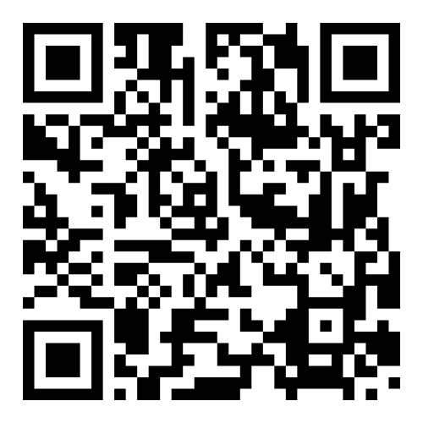
ISEH 2026
27-30 August
Goethe University Frankfurt
Frankfurt, Germany
Abstract Deadline: 17 April
Late-Breaking Abstract Deadline: 19 June
Early Registration Deadline: 16 July
Housing Deadline: 5 August
Learn more at www.iseh.org/Annual-Meeting/55th-Annual-Meeting

